Slide 1




Shelter Animal Outcomes
Ninad Kulkarni Aneesh Kulkarni Ravi Patel Derek Pulaski

Slide 2
Introduction
Every year, approximately 7.6 million companion animals end up in US shelters.
Many animals are given up as unwanted by their owners, while others are picked up after getting lost or taken out of cruelty situations.
Many of these animals find forever families to take them home, but just as many are not so lucky. 2.7 million dogs and cats are euthanized in the US every year.
Using a dataset of intake information including breed, color, sex, and age from the Austin Animal Center, we're to predict the outcome for each animal.
We also believe this can help us understand trends in animal outcomes.
These outcomes include: Adoption, Died, Euthanasia, Return to owner, and Transfer.
These insights could help shelters focus their energy on specific animals who need a little extra help finding a new home.

Slide 3
Dataset
Size: 26,729 rows
Variables:
AnimalID: Unique ID
Name: Animal’s Name (i.e. Buddy, Lucy)
DateTime: Date and Time of Outcome
OutcomeType: Adoption, Transfer, Return to Owner, Euthanasia, Died
OutcomeSubtype: Reason for outcome
AnimalType: Cat or Dog
SexuponOutcome: Gender and if Intact
AgeuponOutcome: Age upon Outcome
Breed: Breed of the animal
Color: Color/Pattern of animal’s fur

Slide 4
Data Preprocessing
Removed blanks from SexuponOutcome and AgeuponOutcome
Removed ‘Unknown’ values
Variables:
AnimalID
Name -> hasName (0 or 1)
DateTime
OutcomeType
OutcomeSubtype
AnimalType
SexuponOutcome
Gender -> Male or Female
IsNeutered -> (0 or 1)
AgeuponOutcome -> AgeinDays
Breed -> IsMix (0 or 1)
Color -> SimpleColor (28 levels)

Slide 5
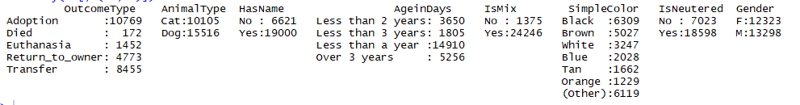
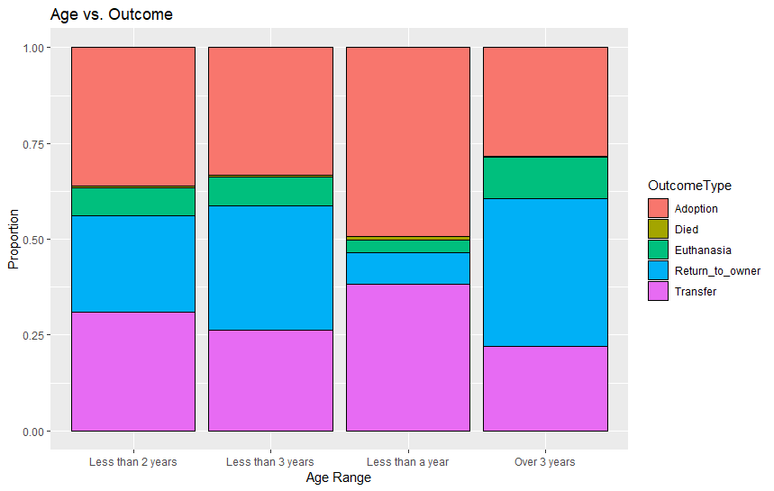
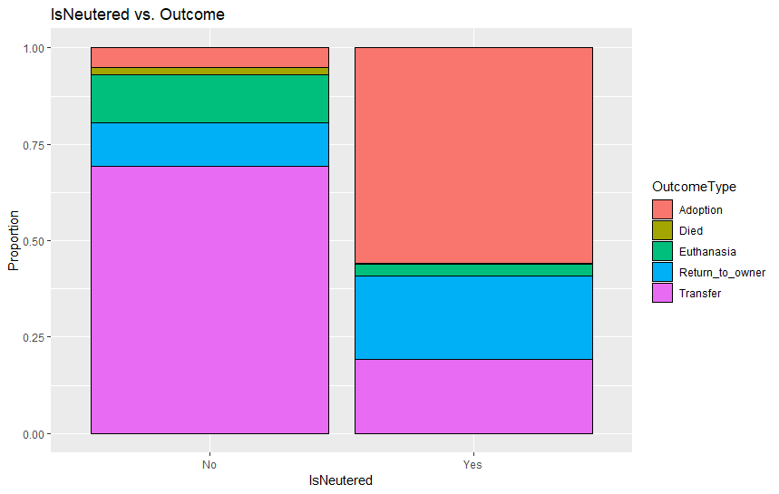
EDA

Slide 6
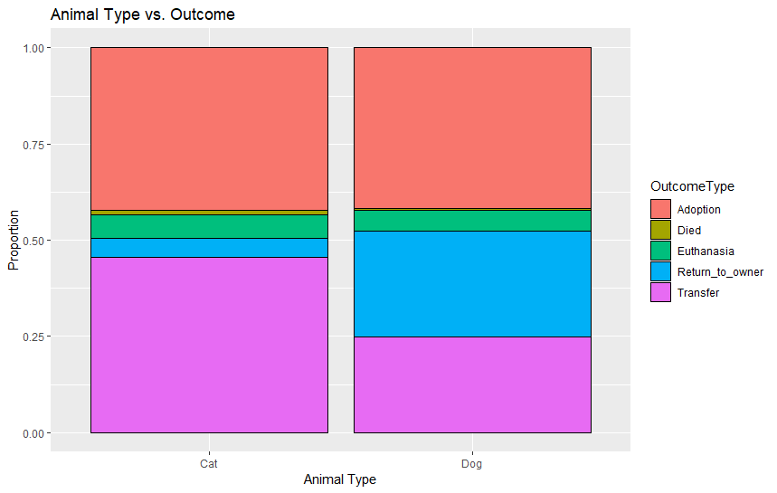
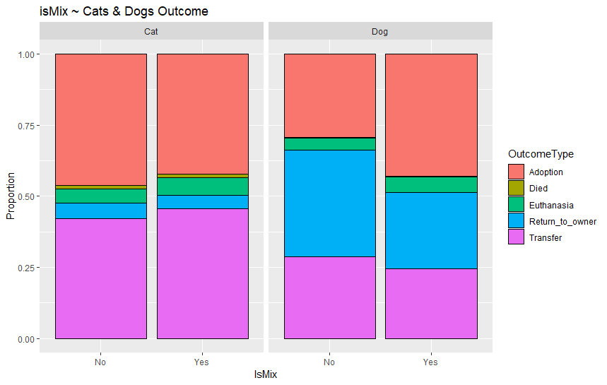
EDA (continued)

Slide 7
The Methodologies
KNN
CART
C5.0
SVM
RandomForest

Slide 8
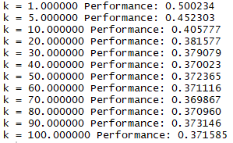
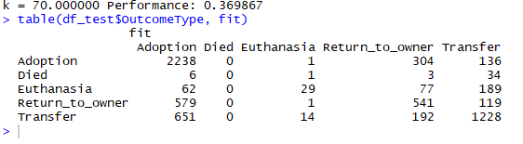
KNN

Slide 9
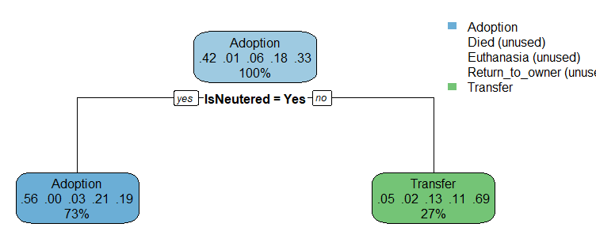
Cart
Tree with Default Complexity Parameter
Error rate: 0.4065574
Notes:
The Default tree produced by cart does not look to fancy. In addition does not go into much depth. However, it does state one major trait that is important in adopting an animal and that is if the animal is neutered or not.

Slide 10
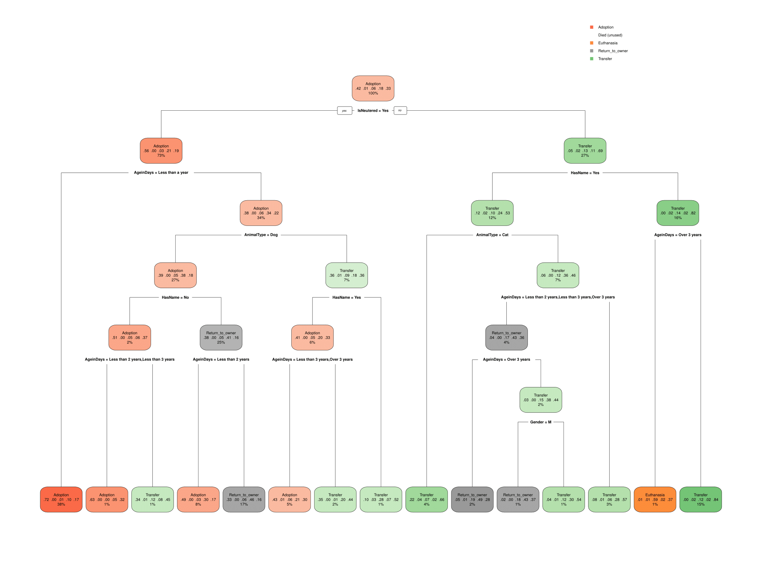
Cart Tree
Lower Complexity Parameter to: 0.001
Error Rate: 0.3667447
Notes:
Changing the complexity parameter to .001 the tree gets complex very quickly. First major change, is the number of branches/levels.
Question order:
-IsNeutered
-Left: AgeinDays (Less than a year) , AnimalType(Dog),
-Right: HasName, AnimalType(Cat)
Overall: We can see that we could not predict animal has Died as an outcome.

Slide 11
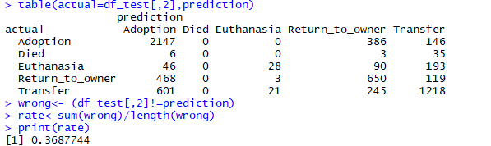
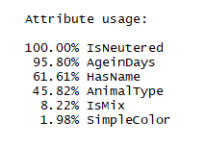
C5.0 Results
Notes:
Also like CART, we could not predict Died as an outcome. Looking at the attributes used, Gender does not play a role

Slide 12
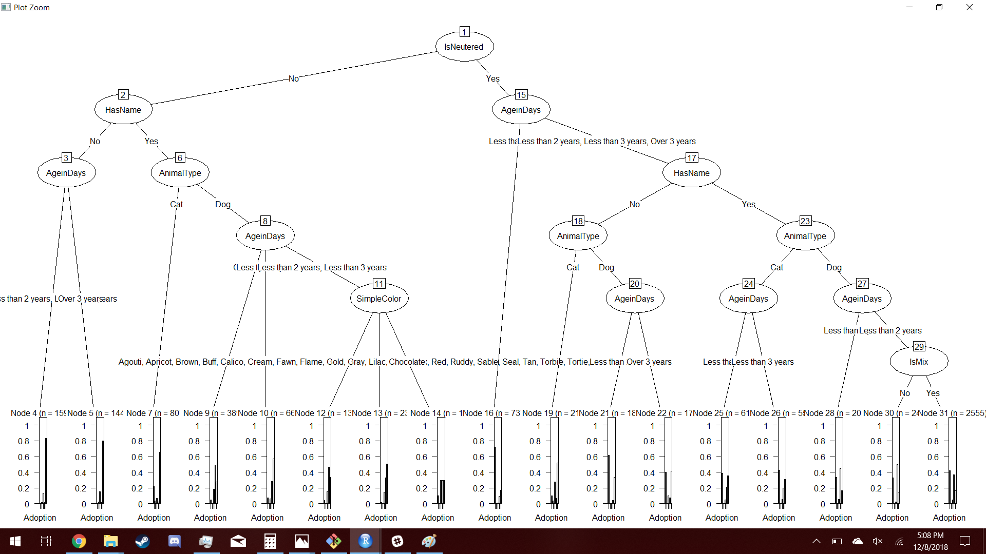
C5.0 Tree
Adoption
Died
Euthanasia
Return_to_Owner
Transfer
Notes:
Looking

Slide 13
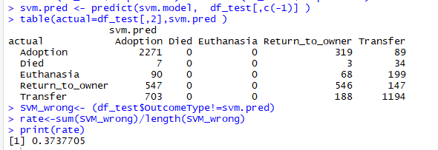
SVM
Notes:
Next we used a support vector machine. Like previous methods it did not predict Died however it also did not predict euthanasia

Slide 14
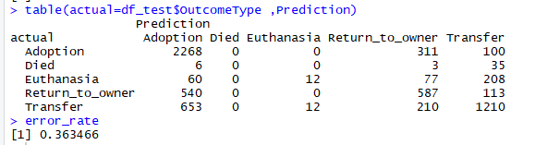
RandomForest Results

Slide 15
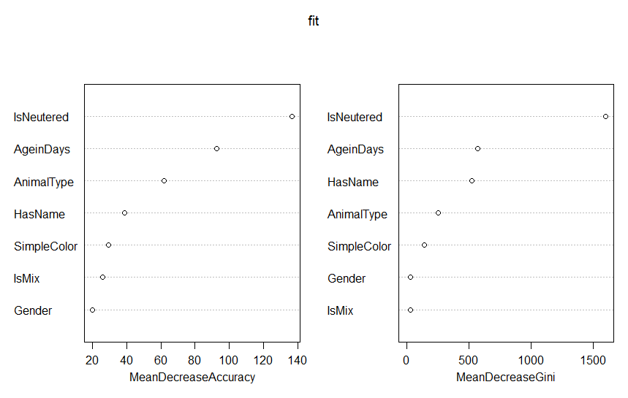
RandomForest Importance

Slide 16
Error Rates
Methodology | Error Rate
KNN (k=70) | 0.369867
CART | 0.3667447
C5.0 | 0.3687744
SVM | 0.3737705
RandomForest | 0.363466

Slide 17
Conclusions
Age and whether or not the animal is neutered are the biggest factors involved in their outcome.
Gender and being mixed breed have little effect on the outcome.
There is not enough data on Died and Euthanasia to predict them consistently.
This lack of data is due to Austin Animal Shelter being a “No Kill Shelter”

Slide 18
Sources
Data: https://www.kaggle.com/c/shelter-animal-outcomes/data
Preprocessing: https://www.kaggle.com/mrisdal/quick-dirty-randomforest

